Slide 1


CAPSTONE PROJECT MACHINE LEARNING- POST OPERATIVE DATASET
GROUP 5:
Tejaswini Kesiraju
K. Sarath Chandra
Pindi Sruthika Reddy

Slide 2
BACKGOUND
New Hope Hospital located in a bustling city. The hospital was renowned for its state-of-the-art facilities, expert medical staff, and exceptional patient care. It was one of the busiest hospitals in the city, with patients coming from all walks of life seeking medical attention. To improve patient outcomes, the hospital decided to implement a machine learning project that would analyse post-operative patient data. The goal was to identify patterns and trends in the data that could help medical staff make more informed decisions about patient care and treatment. To collect the necessary data, the hospital set up a comprehensive post-operative patient monitoring system. The data was then collected and stored in a centralized database that was accessible to us.

Slide 3
OBJECTIVE & PATH
To predict the discharge decision of patients based on other influencing factors
Building classification Machine Learning algorithm for predicting

Slide 4
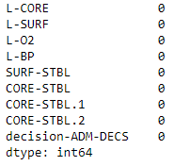
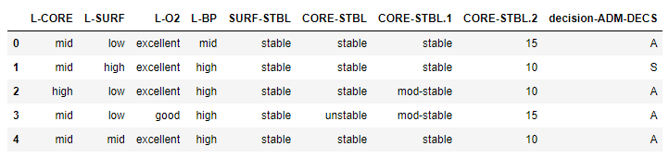
DATA AND DATA QUALITY CHECK
The data contains the records of patients. The variables typically described are the patients internal Temperature, patients surface Temperature, oxygen saturation level in %, last measurement of blood pressure.
There were 8 Categorical variables and one numerical variables. There were no missing values observed in the data set. However, there were few irregularities in the dataset which were corrected using the following ways.
Outliers and extremes were observed and replaced with the relevant elements

Slide 5
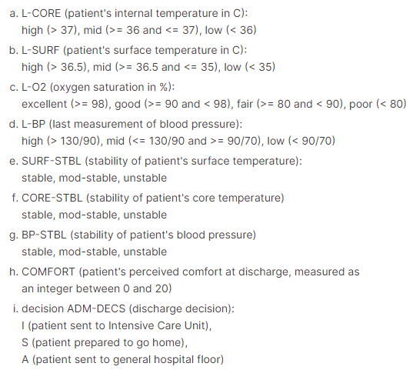
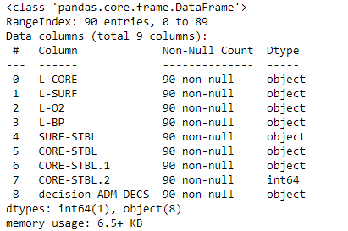
ATTRIBUTES

Slide 6
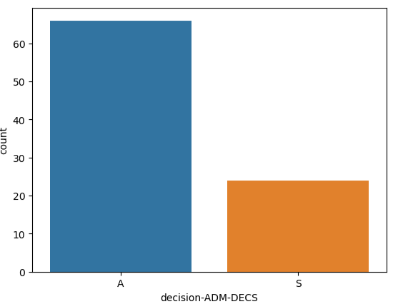
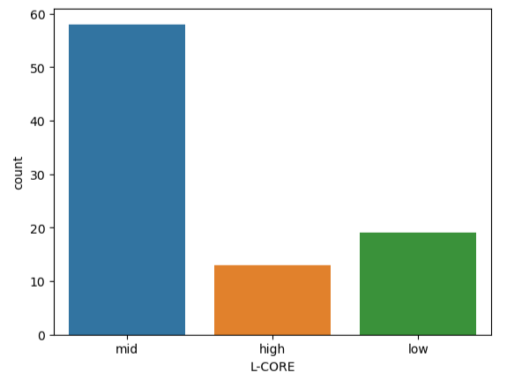
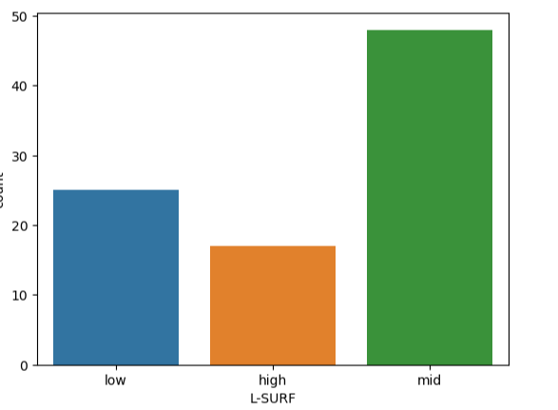
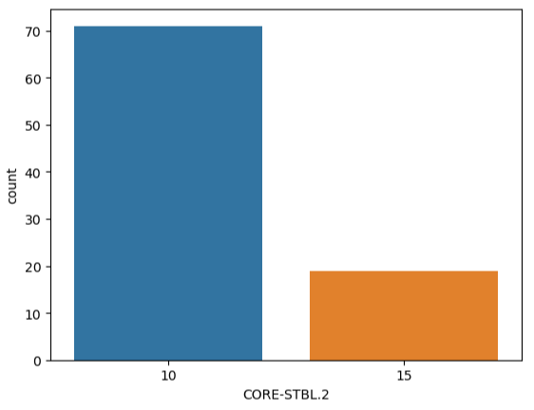
EDA INSIGHTS

Slide 7

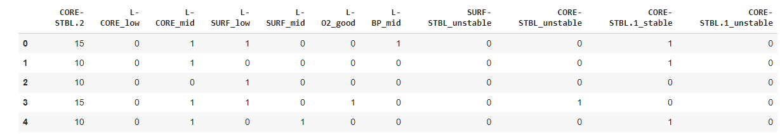
FEATURE SELECTION & ENCODING

Slide 8
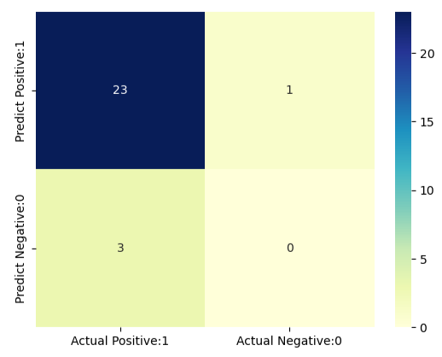
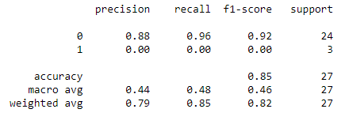


CLASSIFICATION ALGORITHM- LOGISTIC REGRESSION
The logistic regression algorithm works by modeling the probability of the binary outcome using a logistic function, which maps any real-valued input to a value between 0 and 1.

Slide 9
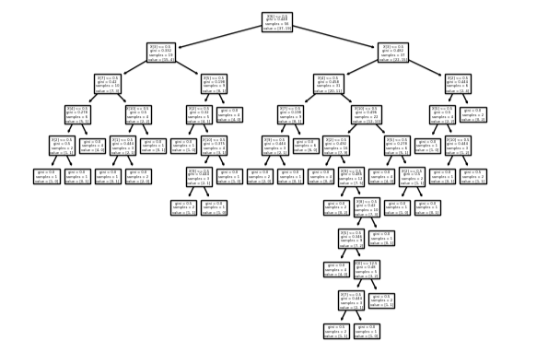

CLASSIFICATION ALGORITHM- DECISION TREE ALGORITHM
For classification tasks, the decision tree predicts the class label of a new data point by traversing the tree from the root to a leaf node, based on the values of the input features.

Slide 10
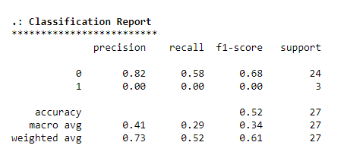
CLASSIFICATION ALGORITHM- KNN
K Nearest Neighbor Algorithm (KNN) model is the predicted class of the test data point is determined by a majority vote of the K nearest neighbors.

Slide 11
CONCLUSIONS
After seeing accuracy scores of all the three classification models, we are able achieve highest accuracy using logistic algorithm.
The model would be correct 85% of the time in predicting the outcome for that observation.
An F-score of 0.92 in logistic regression means that the model has good overall performance in terms of both precision and recall.
A precision of 0.88 in logistic regression means that among the observations that the model predicted to be positive, 88% of them were positive. A recall of 0.96 in logistic regression means that among all the actual positive cases in the dataset, the model correctly identified 96% of them as positive.

Slide 12
FUTURE & LIMITATIONS
Algorithm-based discharge decision making in hospitals can add value to the business in several ways Improved patient outcomes, Improved operational efficiency, Reduces costs, and Improved risk management
In summary, while a logistic regression model with an accuracy score of 0.85 and an F1 score of 0.92 is a good indication of its performance on the given training data, it's important to keep in mind that the model's performance on future data cannot be guaranteed and should be monitored and evaluated regularly

Slide 13

THANK YOU

